Slide 1
Lightning Talks
Week 2: User Needs & Requirements

Slide 2
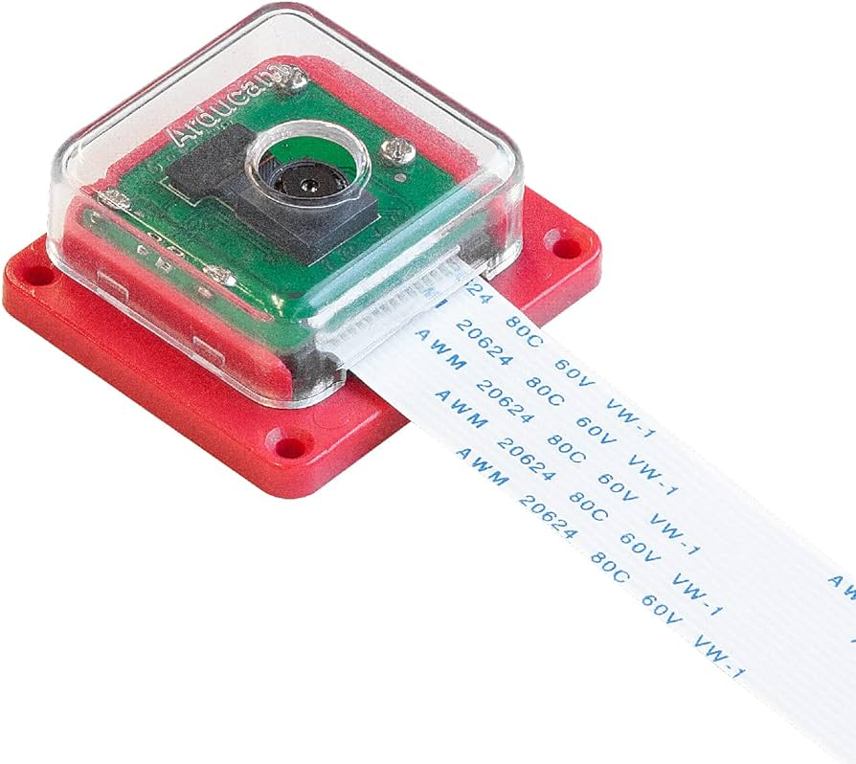
Project Overview
We will be developing a video pipeline from a MIPI-connected COTS camera module to a video monitor
The MIPI video data will be sent through a custom FPGA-based video pipeline
The augmented video will be sent to a monitor connected via an active displayport cable
The software will execute within a Linux operating system
STRETCH GOAL: Video may be passed into a machine learning algorithm and the output of the ML algorithm will be used to augment the video sent to the monitor

Slide 3
User Needs
Ethyl needs a way to consistently navigate and perform her daily tasks without risk of injury or fatigue because she has limited fine motor skills due to her disability.
Nurse Jackie needs a more effective and efficient way of taking care of their patients that is easy to learn so that they can have more time to take care of multiple patients at the same time.
Elon needs a device that easily processes video data for machine learning applications because he wants to create an innovative product.

Slide 4
Function Requirements
Functional
The product will compute machine learning in real-time
Software that routes data will use a Linux image
The product will use C and Python code
The product will need to work in a variety of lighting conditions
Resource
The product will require a 12V power input
Physical
The product will use a Sony IMX219PQH5-C image sensor
The product will use an Ultra96-v2 FPGA board
The product will utilize off-the-shelf and open source components
User experiential
Output is sent through mini DisplayPort
Environmental
The product will take a video feed as input from the image sensor
The product will need to withstand wear and tear from normal weather conditions

Slide 5
Important Requirements
Product is durable, consistent, reliable and should:
Function in a variety of lighting conditions
Withstand wear and tear from normal weather conditions
The product should reliably aid in communication and navigation and must:
Compute machine learning in real time
Notes:
The product will need to work in a variety of lighting conditions and will need to withstand wear and tear from normal weather conditions. This is due to the fact that one application for this product will be to mount it to a motorized wheelchair to help someone with a disability. This means that this device will need to be both durable, consistent, and reliable in order for it to be useful. This device will be required to compute machine learning in real time. This is important because the product will be actively and constantly throughout the day. Immediate response is necessary in order to reliably aid in communication and navigation.

Slide 6
Engineering Standards
The video stream from the image sensor will be sent to a MIPI controller for conversion before being sent to the Ultra96-v2 FPGA board.
IEEE MIPI standards: https://standards.ieee.org/ieee/2977/10543/
I2C protocol
https://ieeexplore.ieee.org/document/4762946
For wifi connectivity
https://standards.ieee.org/ieee/802.11/5536/

Slide 7
Conclusion
This product implements a video pipeline for computer vision system in C and Python code working on a Linux image. The hardware is off the shelf commonly available components and sensors designed with a focus in aiding disabled or injured users, however there are many other applications outside of this area of focus.

